Slide 1




SQL • POWER BI • PYTHON • MACHINE LEARNING
Online Shoppers Purchasing Intention Analysis & Prediction
An end-to-end data analytics and machine learning project predicting purchase
intent from 12,330 e-commerce browsing sessions
SQL Analysis
EDA & Dashboard
ML Experiments
Final Model
Prepared by Komal Kakkar
github.com/komalkakkar1996-source

Slide 2



ROADMAP
What We'll Cover Today
Business Problem & Dataset
Power BI Dashboard
Objectives, scope, and the 18-feature session-level dataset
Interactive KPI dashboard for stakeholders
Data Cleaning & Preprocessing
Machine Learning Experiments
Duplicate removal, missing values, outlier treatment
4 experiments: Logistic Regression, transformations, class weighting, tree models
Exploratory Data Analysis
Final Model & Recommendations
Univariate, bivariate, and correlation insights
Model comparison, ranking, and business recommendations
SQL Business Analysis
18 business questions answered directly in SQL
ONLINE SHOPPERS PURCHASING INTENTION | DATA ANALYTICS & MACHINE LEARNING PROJECT
2 / 20

Slide 3



BUSINESS UNDERSTANDING
Problem Statement & Objectives
Predict Purchase Intent
The Problem
Classify sessions as revenue-generating or not, using browsing signals
E-commerce businesses often struggle to understand why some users purchase products while others leave the website without converting. Most visitors browse and exit without buying, and businesses need to know which behavioral signals separate buyers from non-buyers.
Target High-Intent Visitors
Help marketing teams personalize offers for likely buyers
Improve Conversion Rate
Turn behavioral insight into concrete conversion-boosting actions
The goal is to build a machine learning model that predicts whether a visitor is likely to make a purchase, based on browsing behavior, session characteristics, and website interaction data.
Reduce Wasted Spend
Identify low-quality traffic and disengaged segments to cut costs
ONLINE SHOPPERS PURCHASING INTENTION | DATA ANALYTICS & MACHINE LEARNING PROJECT
3 / 20

Slide 4


THE DATA
Dataset Overview
12,330
18
10
15.63%
Total Sessions
Original Features
Months Covered
Overall Conversion Rate
Each row represents one customer browsing session on an e-commerce site. Features fall into four business-meaningful groups:
User Behavior
Interaction Metrics
Visitor Information
Session Context & Target
Administrative, Informational & ProductRelated page counts and durations
BounceRates, ExitRates, PageValues, SpecialDay proximity
VisitorType (New/Returning), Region, Browser, OperatingSystem, TrafficType
Month, Weekend flag, and the target — Revenue (purchase made or not)
ONLINE SHOPPERS PURCHASING INTENTION | DATA ANALYTICS & MACHINE LEARNING PROJECT
4 / 20

Slide 5
Data Cleaning & Preprocessing
1
Shape Check:
12,330 rows × 18 features confirmed
# Remove exact duplicates
df.drop_duplicates(inplace=True)
print("Shape:", df.shape) # (12205, 18)
# Fix dtypes
df["Revenue"] = df["Revenue"].astype(int)
df["Weekend"] = df["Weekend"].astype(int)
# Fix month inconsistency
df["Month"] = df["Month"].replace("June","Jun")
# Feature engineering
df['TotalPages'] = (df['Administrative']
+ df['Informational']
+ df['ProductRelated'])
df['TotalDuration'] = (
df['Administrative_Duration']
+ df['Informational_Duration']
+ df['ProductRelated_Duration’])
# Missing value scan
df.isnull().sum()
2
Duplicate Removal:
125 exact duplicates removed — identical floats impossible for real users
3
Missing Values:
Zero missing values across all 18 columns
4
Data Type Fix:
Revenue & Weekend converted from bool → int
5
Month Fix:
'June' → 'Jun' for consistency
6
Validation:
BounceRate & ExitRate within [0,1] — no invalid values
7
Feature Engineering:
TotalPages & TotalDuration created from sub-features
125
12,205
0
2
Duplicates Removed
Clean Sessions
Missing Values
New Features Added

Slide 6

EXPLORATORY DATA ANALYSIS
Univariate Analysis — Key Findings
Categorical variables (Region, Browser, TrafficType, Weekend) were analyzed by frequency distribution; numerical variables were analyzed via histograms and boxplots.
Product Pages Dominate Engagement
Returning Visitors Are 77% of Traffic
PageValues Are Near-Zero for Most Sessions
May & November Are the Only High-Traffic Months
The site has a massive loyal base that barely converts. Even a small improvement here means a big revenue impact.
Almost all sessions contribute no revenue signal at all — purchases are driven by a small fraction of high-PageValue sessions.
These two months alone dominate overall session volume across the year.
Users spend 1,206 seconds on average on product pages — dwarfing all other page types. That's where the entire conversion opportunity lives.
ONLINE SHOPPERS PURCHASING INTENTION | DATA ANALYTICS & MACHINE LEARNING PROJECT
6 / 20

Slide 7
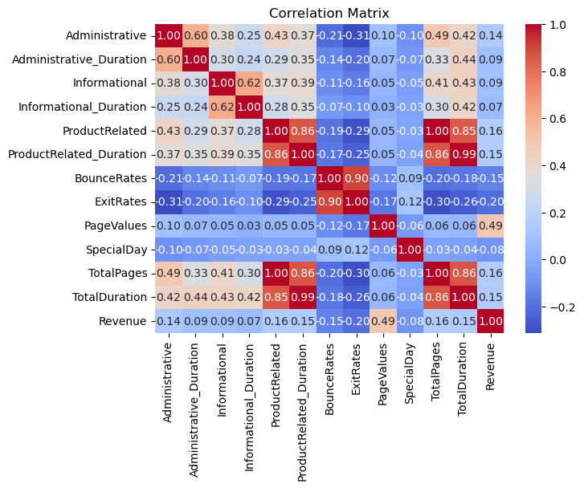
EXPLORATORY DATA ANALYSIS
Correlation Analysis
Numerical Feature Correlation Heatmap
BounceRates ↔ ExitRates
0.90
Very strong positive correlation — a visitor who bounces on one page tends to exit quickly elsewhere too.
ProductRelated ↔ ProductRelated_Duration
0.86
Strong positive correlation — more product pages viewed naturally means more time spent browsing them.
PageValues ↔ Revenue
High
Sessions with higher page values are far more likely to convert — the strongest revenue signal in the data.
ONLINE SHOPPERS PURCHASING INTENTION | DATA ANALYTICS & MACHINE LEARNING PROJECT
7 / 20

Slide 8
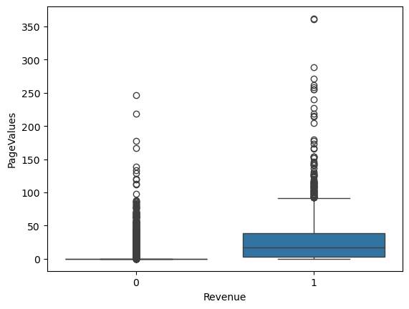
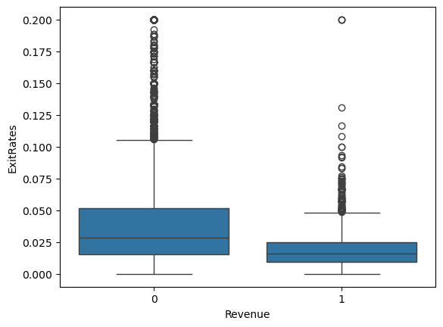
EXPLORATORY DATA ANALYSIS
Bivariate Analysis & Key Findings
KEY FINDING SUMMARY
PageValues of buyers are 13.6x higher than non-buyers.
Buyers have 4.5x lower bounce rates than non-buyers.
Only 15.63% of visitors actually buy — 84.37% browse and leave
Buyers spend 73% more time on product pages (1,876s vs 1,083s for non-buyers)
New visitors convert at 24.9% vs returning visitors at only 14.1%
November converts best (25.49%), February worst (1.66%) — a 15x seasonal swing
ONLINE SHOPPERS PURCHASING INTENTION | DATA ANALYTICS & MACHINE LEARNING PROJECT
07
Notes:
Numerical features mostly right-skewed hain - outliers bhi kaafi hain especially PageValues aur duration columns mein. Sabse important insight yeh hai ki buyers product pages par 73% zyada time spend karte hain non-buyers ke comparison mein, aur PageValues almost sabhi non-converting sessions ke liye zero ke close hai.

Slide 9
EXPLORATORY DATA ANALYSIS
The Story the Data Tells
15.63%
73% more
15x
Overall conversion rate — 84.37% of visitors browse and leave without buying
time spent on product pages by buyers (1,876s) vs non-buyers (1,083s)
difference between best month, November (25.49%), and worst, February (1.66%)
2x
4.5x
13.6x
New visitors convert at 24.9% vs returning visitors at just 14.1%
lower bounce rate for buyers (0.005) vs non-buyers (0.023)
higher PageValues for buyers (27.26) vs non-buyers (2.0)
ONLINE SHOPPERS PURCHASING INTENTION | DATA ANALYTICS & MACHINE LEARNING PROJECT
10 / 20

Slide 10
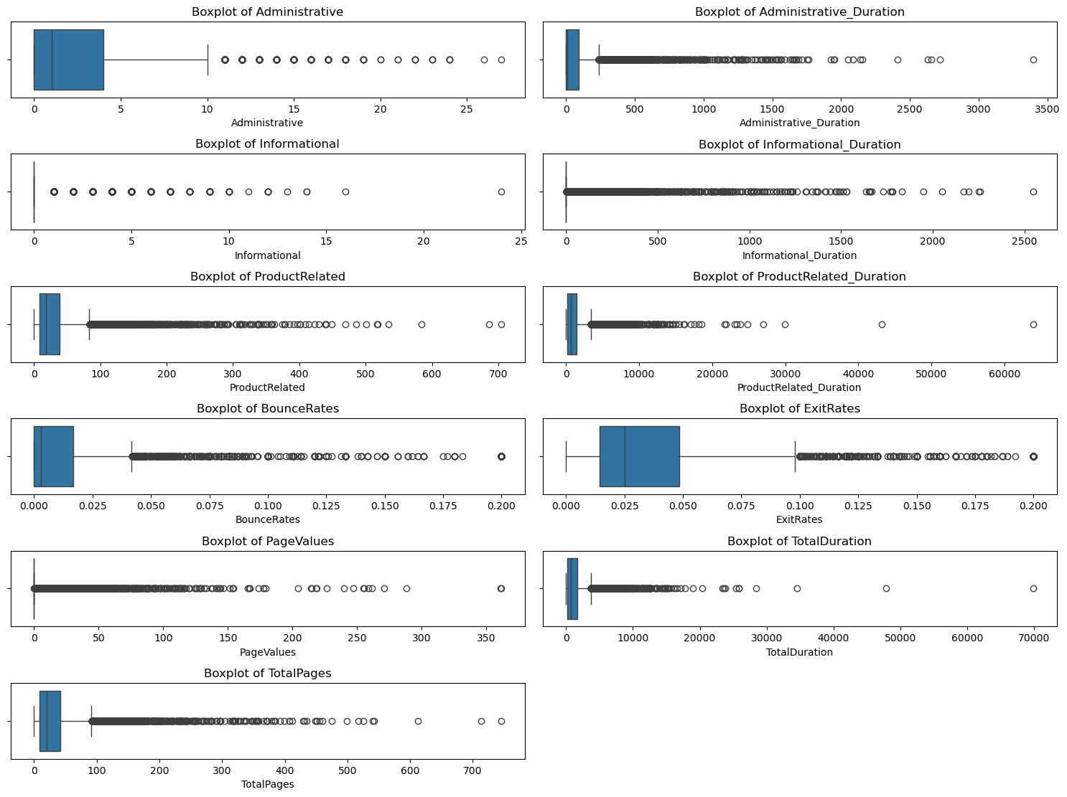
PREPROCESSING
Outlier Detection (IQR Method)
IQR METHOD
Q1 = df[col].quantile(0.25)
Q3 = df[col].quantile(0.75)
IQR = Q3 - Q1
lower = Q1 - 1.5 * IQR
upper = Q3 + 1.5 * IQR
outliers = df[(df[col]<lower)|(df[col]>upper)]
WHY OUTLIERS EXIST
Administrative / Informational pages: a small group of power-users visit repeatedly (order history, FAQs, policies) creating high variance
ProductRelated & Duration — comparison shopping or idle browser tabs left open
BounceRates — irrelevant traffic or accidental clicks causing instant exits
ExitRates — checkout abandonment or comparison browsing before leaving
PageValues — a small group of high-value customers on high-converting pages
Decision: outliers were retained (not removed) since they represent real high-value buyer behaviour critical to the target variable
ONLINE SHOPPERS PURCHASING INTENTION | DATA ANALYTICS & MACHINE LEARNING PROJECT
09
Notes:
Outlier detection ke liye maine IQR method use kiya. Interesting baat yeh hai ki maine outliers ko remove nahi kiya kyunki yeh genuine high-value buyer behaviour represent karte hain - jaise koi user jo product pages par bohot zyada time spend karta hai, woh actually high purchase intent signal hai, noise nahi.

Slide 11
SQL BUSINESS ANALYSIS
Answering Business Questions in SQL
18 business questions were answered directly in SQL against the cleaned online_shoppers table — each paired with an insight and an actionable recommendation.
SQL — CONVERSION RATE BY MONTH
SELECT Month,
ROUND(AVG(Revenue) * 100, 2)
AS Conversion_Rate
FROM project.online_shoppers
GROUP BY Month
ORDER BY Conversion_Rate DESC;
INSIGHT
November and October recorded the highest conversion rates, showing strong seasonal purchase intent during festive/sale periods.
RECOMMENDATION
Increase marketing campaigns and promotional offers during high-conversion months to maximize revenue.
ONLINE SHOPPERS PURCHASING INTENTION | DATA ANALYTICS & MACHINE LEARNING PROJECT
11 / 20

Slide 12
SQL BUSINESS ANALYSIS
More SQL-Driven Insights
Business Question | Key Insight | Recommendation
Which visitor type generates highest page value? | New Visitors generate higher PageValues per session than Returning Visitors. | Focus on converting new visitors with personalized onboarding.
Which traffic sources convert best / worst? | Traffic Types 16, 7, 8 perform best; several sources have near-zero conversions. | Invest in high-performing channels; optimize or cut weak ones.
Do bounce rates affect conversion? | Converted users have much lower bounce rates than non-converters. | Optimize landing pages and ad targeting to reduce bounce behavior.
Do weekend visitors convert better? | Weekend visitors show slightly higher conversion rates than weekdays. | Increase weekend promotions and targeted campaigns.
Which regions contribute highest revenue? | Regions 9, 2, 1, and 5 show the highest conversion rates; Region 8 lowest. | Focus regional marketing on top regions; improve weak markets.
Does SpecialDay proximity drive purchases? | Conversion is actually highest when SpecialDay = 0 (regular periods). | Don't rely only on holiday promos — sustain year-round engagement.
ONLINE SHOPPERS PURCHASING INTENTION | DATA ANALYTICS & MACHINE LEARNING PROEJCT
12 / 20

Slide 13
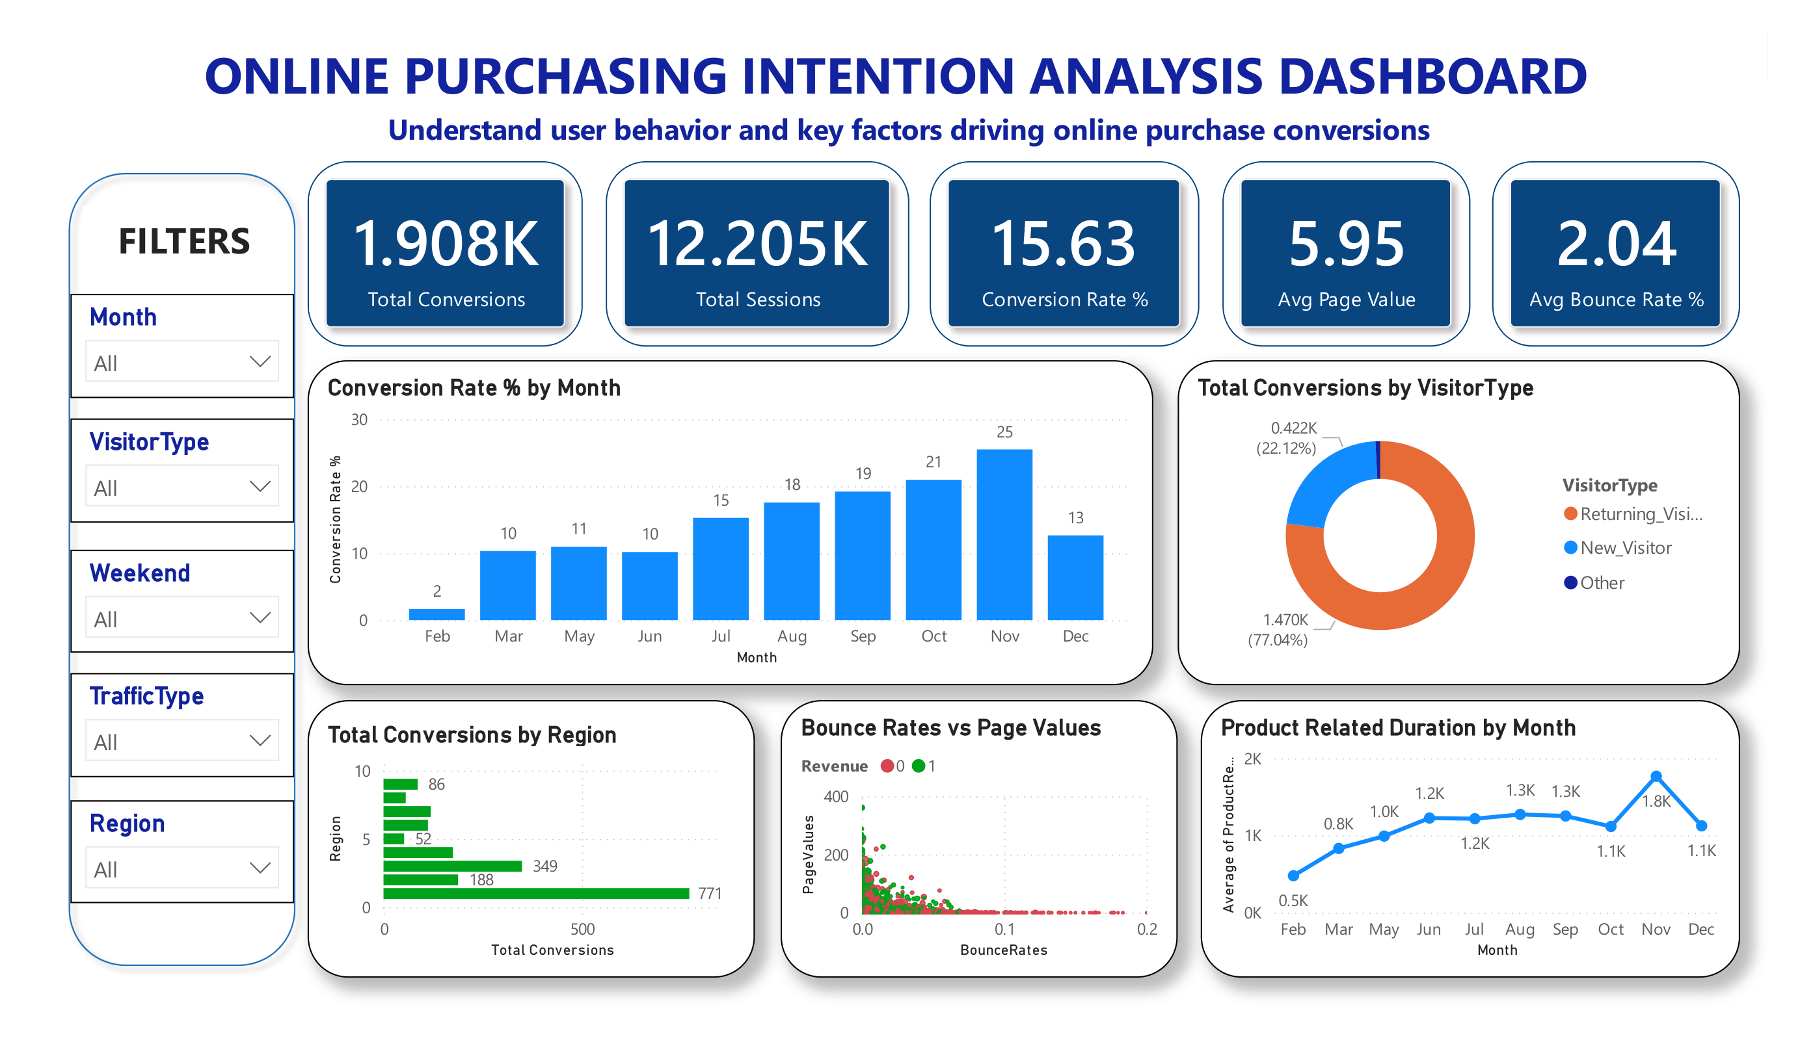
POWER BI DASHBOARD
Interactive KPI Dashboard
KPI Cards (5)
Total Conversions (1.908K) · Total Sessions (12.205K) · Conversion Rate % (15.63) · Avg Page Value (5.95) · Avg Bounce Rate % (2.04)
Conversion Rate by Month (Bar)
Column chart showing monthly trend — Nov peaks at 25%. Used to identify seasonal revenue opportunities.
Total Conversions by Visitor Type (Donut)
77.04% Returning Visitors · 22.12% New Visitors. Reveals the paradox: Returning dominate traffic but New Visitors convert better.
Total Conversions by Region (Bar)
Horizontal bar: Region 1 leads with 771 conversions, Region 2 with 349. Supports regional campaign planning.
Bounce Rate vs Page Values (Scatter)
Revenue-coded scatter: Green dots (purchases) cluster at low bounce & high page value. Visually proves the engagement-conversion correlation.
Product Duration by Month (Line)
Line chart of avg product browsing duration — Nov highest at 1.8K sec. Guides campaign timing for content-heavy months.
Filters: Month · VisitorType · Weekend · TrafficType · Region — enabling stakeholders to slice conversion behavior interactively.
ONLINE SHOPPERS PURCHASING INTENTION | DATA ANALYTICS & MACHINE LEARNING PROJECT
13 / 20

Slide 14
MACHINE LEARNING
Four Experiments,
One Objective
From a simple linear baseline to a fully tuned ensemble model — systematically improving Recall & F1-Score on an imbalanced target.
EXP 1
EXP 2
EXP 3
EXP 4
Baseline
Logistic Regression
Establish a benchmark with raw scaled features
Log1p &
Yeo-Johnson + LR
Reduce skewness in duration/value features
Transform +
Class-Weighted LR
Address class imbalance (only 15.6% positive)
Tuned Decision Tree
& Random Forest
Capture non-linear patterns; tune with search CV
ONLINE SHOPPERS PURCHASING INTENTION | DATA ANALYTICS & MACHINE LEARNING PROJECT
Notes:
Ab main deep dive karti hoon 4 experiments mein. Har experiment mein maine ek naya technique add kiya - preprocessing transformations se lekar class balancing aur finally tree-based ensemble models tak - taaki minority class (buyers) ko better predict kiya ja sake.

Slide 15
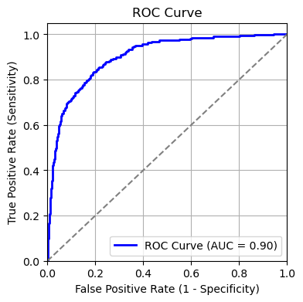
EXPERIMENT 1
Baseline Logistic Regression
plain sklearn LogisticRegression, no class balancing, no transformation -- purely to see how a linear model performs “out of the box” on an imbalanced 84:16 target
89%
0.77
0.42
0.54
0.902
Encoding: pd.get_dummies() on Month & VisitorType (drop_first=True)
Split: 80/20 train-test, stratified on Revenue to preserve class ratio
Scaling: RobustScaler (robust to the outliers we chose to keep)
Model: plain sklearn LogisticRegression, no class balancing, no transformation
Test Accuracy
Precision
Recall
F1-Score
ROC-AUC
Takeaway
The baseline model serves as the benchmark. It achieved the highest Precision of the five experiments (0.77) but a very low Recall (0.42) — meaning it missed a large share of actual buyers. This motivated exploring feature transformations and class weighting in later experiments.
Test ROC-AUC = 0.902
Confusion Matrix (Test Set)
 | Pred: No | Pred: Yes
Actual: No | 2,012 | 47
Actual: Yes | 223 | 159
Why it under-detects buyers
With only 15.6% of sessions converting, a plain Logistic Regression naturally leans toward predicting the majority class (“no purchase”) — which is exactly the imbalance problem Experiments 2–4 address.
ONLINE SHOPPERS PURCHASING INTENTION | DATA ANALYTICS & MACHINE LEARNING PROJECT
15 / 20

Slide 16
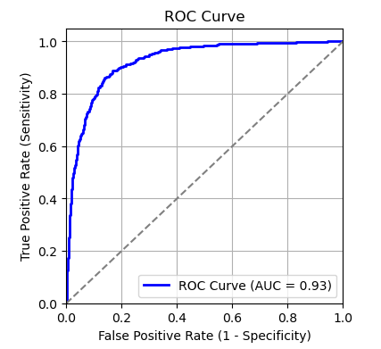
EXPERIMENT 2
Fixing Skewness — Log1p vs Yeo-Johnson
Numeric features (durations, PageValues) were heavily right-skewed. Two transformations were tested to normalise them before feeding into Logistic Regression.
Metric | Log1p + LR | Yeo-Johnson + LR
Test Accuracy | 90.29% | 89.79%
Precision | 0.72 | 0.70
Recall | 0.61 | 0.60
F1-Score | 0.66 | 0.65
Test ROC-AUC | 0.927 | 0.920
WINNER
Log1p
Wins on Accuracy, Precision, Recall, F1 and ROC-AUC — simpler transform, better outcome.
TEST ROC — Log1p + LR
Conclusion: Although Yeo-Johnson reduced skewness more, Log1p gave better predictive performance on every metric. Log1p was carried forward into Experiment 3.
ONLINE SHOPPERS PURCHASING INTENTION | DATA ANALYTICS & MACHINE LEARNING PROJECT
13
Notes:
Experiment 2 mein maine skewness fix karne ke liye do transformations try kiye - Log1p aur Yeo-Johnson. Log1p simple hai aur zeros ko safely handle karta hai. Yeo-Johnson thoda advanced power transform hai jo skewness ko aur zyada effectively reduce karta hai.

Slide 17
EXPERIMENT 3
Handling Class Imbalance — class_weight='balanced'
Only 15.63% of sessions convert. Instead of resampling (SMOTE), class_weight='balanced' was used inside Logistic Regression to penalise misclassifying the minority (buyer) class more heavily.
RECALL JUMPS FROM 0.61 → 0.81
lr = LogisticRegression(
class_weight='balanced',
random_state=42,
max_iter=1000)
lr.fit(X_train_scaled, y_train)
Class weighting makes the model far more sensitive to buyers — it now catches 80% of real purchasers (vs 42% in the baseline). The trade-off: more false positives, so Precision drops to 0.56 and Accuracy to 87%.
When to use this model: when the cost of missing a real buyer is higher than the cost of contacting a few extra non-buyers (e.g. cart-abandonment email campaigns).
Metric | Log1p+CW | Yeo-J+CW
Accuracy | 87% | 86%
Precision | 0.56 | 0.54
Recall | 0.81 | 0.83
F1-Score | 0.66 | 0.65
ROC-AUC | 0.929 | 0.923
Conclusion: Log1p + Class Weight selected over Yeo-Johnson + Class Weight — better Accuracy, Precision, F1 & ROC-AUC, with Recall only marginally lower (0.81 vs 0.83).
15
Notes:
Experiment 3 mein maine class_weight='balanced' add kiya taaki minority class ko zyada importance mile. Isse Recall 0.61 se 0.80 tak jump kar gaya - matlab ab model 80% actual buyers ko catch kar raha hai. Trade-off yeh hai ki Precision aur Accuracy thodi kam ho gayi. Yeh model tab useful hai jab missed buyer ka cost zyada ho extra contacted non-buyer ke comparison mein.

Slide 18
EXPERIMENT 4A
Decision Tree — Default vs GridSearchCV Tuned
Log1p-transformed features carried forward. A default Decision Tree overfit badly (100% train accuracy) — GridSearchCV was used to tune it.
Metric | Default DT | Tuned DT
Train Accuracy | 1.00 (overfit) | 0.87
Test Accuracy | 86.03% | 85.25%
Precision | 0.55 | 0.52
Recall | 0.55 | 0.81
F1-Score | 0.55 | 0.63
param_grid = {
'max_depth': [3,5,7,10,None],
'min_samples_split': [2,5,10,20],
'min_samples_leaf': [1,2,5,10],
'criterion': ['gini','entropy'],
'max_features': [None,'sqrt','log2']}
grid_dt = GridSearchCV(dt, param_grid, cv=5,
scoring='f1', n_jobs=-1)
# 480 candidates x 5 folds = 2400 fits
Best Params: criterion='gini', max_depth=7, min_samples_leaf=5, min_samples_split=20 | Best CV F1 = 0.642
Tuning removed the massive train/test gap (overfitting) and boosted Recall to 0.81, though it stays behind Logistic Regression + Class Weight overall.
16
Notes:
Decision Tree ka default version bohot overfit ho gaya tha - train accuracy 100% aur test sirf 86%. GridSearchCV se maine 480 combinations try kiye 5-fold cross validation ke saath, total 2400 fits. Tuning ke baad overfitting kaafi kam ho gayi aur Recall 0.81 tak improve hua, lekin overall yeh Logistic Regression se peeche hi raha.

Slide 19
EXPERIMENT 4B
Random Forest — Default vs RandomizedSearchCV Tuned
Metric | Default RF | Tuned RF
Train Accuracy | 1.00 (overfit) | 0.947
Test Accuracy | 90.20% | 89.34%
Precision | 0.76 | 0.64
Recall | 0.55 | 0.75
F1-Score | 0.64 | 0.69
ROC-AUC (test) | 0.924 | 0.928
param_dist = {
'n_estimators': [100,200,300,500],
'max_depth': [5,10,15,20,None],
'min_samples_split': [2,5,10,20],
'min_samples_leaf': [1,2,5,10],
'max_features': ['sqrt','log2'],
'bootstrap': [True, False]}
random_rf = RandomizedSearchCV(rf, param_dist,
n_iter=30, cv=5, scoring='f1', n_jobs=-1)
# 30 candidates x 5 folds = 150 fits
Best Params: n_estimators=300, max_depth=15, min_samples_split=10, min_samples_leaf=2, max_features='log2' | Best CV F1 = 0.686
Best model of all 4 experiments — highest F1 (0.69) and strong ROC-AUC (0.929), with balanced Precision & Recall.
17
Notes:
Random Forest bhi default version mein overfit hua tha. RandomizedSearchCV se 30 random combinations try kiye, 150 total fits - GridSearch se kaafi fast. Tuned Random Forest ne sabse best F1-score aur ROC-AUC diya poore 4 experiments mein - yeh humara best performing model ban gaya.

Slide 20
FINAL COMPARISON
All Five Experiments, Side by Side
Rank | Experiment | Accuracy | Precision | Recall | F1 | ROC-AUC
1 | Random Forest (tuned) — FINAL MODEL | 89% | 0.64 | 0.75 | 0.69 | 0.928
2 | Logistic Regression + Log1p | 90.29% | 0.72 | 0.61 | 0.66 | 0.926
3 | Logistic Regression + Log1p + Class Weight | 87% | 0.56 | 0.81 | 0.66 | 0.929
4 | Decision Tree (tuned) | 85% | 0.52 | 0.81 | 0.63 | 0.919
5 | Logistic Regression (baseline) | 89% | 0.77 | 0.42 | 0.54 | 0.902
Final Recommendation: Tuned Random Forest
Although Log1p Logistic Regression achieved the highest raw accuracy (90.29%), accuracy alone is not sufficient on this imbalanced dataset. The tuned Random Forest offers the best overall balance — highest F1-score (0.69) and excellent ROC-AUC (0.929) — making it the most suitable model for production use in identifying real buyers while minimizing missed opportunities.
ONLINE SHOPPERS PURCHASING INTENTION | DATA ANALYTICS & MACHINE LEARNING PROJECT
19 / 20

Slide 21

BUSINESS IMPACT
Recommendations & Conclusion
Build a Seasonal Calendar
✂
Cut Low-Quality Traffic
Plan campaigns, stock, and offers from September onward instead of waiting for November; use Feb–Mar for brand awareness and list-building.
Traffic types with near-zero conversion and high bounce rates (15, 17, 18) should be re-targeted or de-prioritized in ad spend.
Re-engage Returning Visitors
Invest in Product Page
Returning visitors are 77% of traffic but convert less than new visitors — loyalty offers and remarketing can close this gap.
Add detailed descriptions, reviews, comparison tools, and smart related-product sections. This is where the purchase decision is made.
The data tells a clear story: engaged users buy, disengaged users don't. A production-ready Random Forest model, paired with these seasonal and segment-level actions, gives the business a concrete path to lift the 15.63% conversion rate.
github.com/komalkakkar1996-source
20 / 20

